Slide 1
Hall B Gas System Controls
Physics Detector Support Group

Slide 2
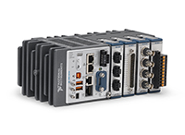
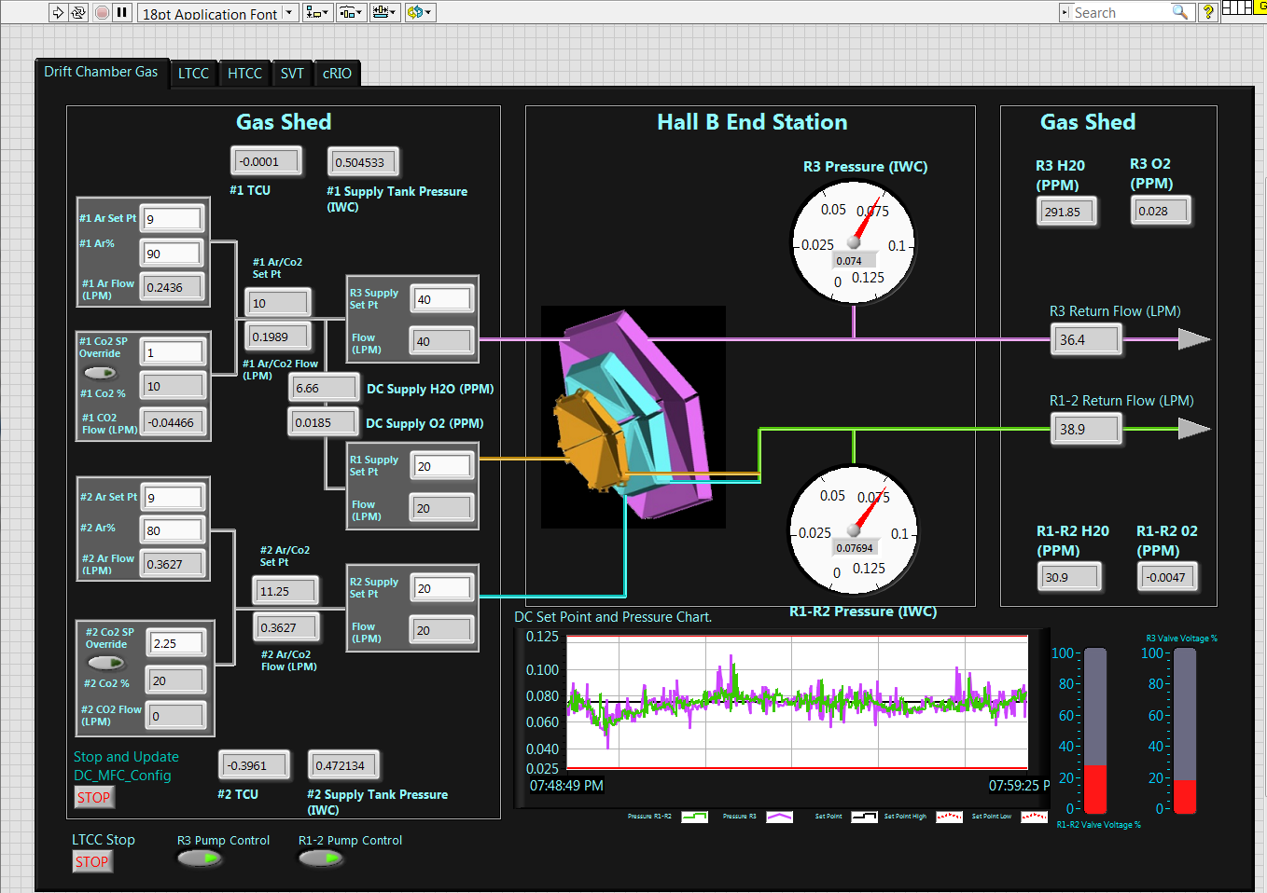
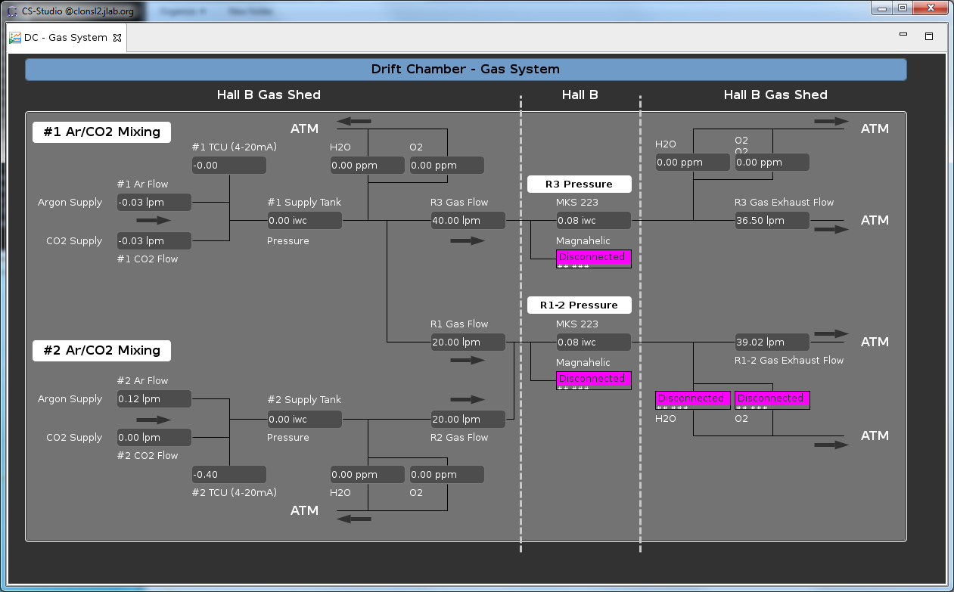
Hall B Controls Setup
Hall B’s gas systems are controlled by three individual setups which work in concert over the slow controls network (160) to provide operational control to a user in the Hall B gas shed, while also providing monitoring data in the form of process variables to the CLAS 12 EPICs system in the counting house.
National Instruments compact RIO DaQ and controls.
Process Variable to EPICS
National Instruments LabView software in gas shed.
Custom controls interface chassis with touchscreen monitor
EPICS monitoring screen in counting house.

Slide 3
Hall B DC Gas Controls GUI

Slide 4
Hall B DC Gas EPICS Monitoring Screen

Slide 5
Gas System Controls
4 Detector gas system controls have been developed and are being tested.
Drift Chamber
Low Threshold Cherenkov Counter
High Threshold Cherenkov Counter
Silicon Vertex Tracker
3 Detector systems in planning/development
(No purchased equipment)
RICH
Micro-Megas Vertex Tracker
Forward Tagger

Slide 6
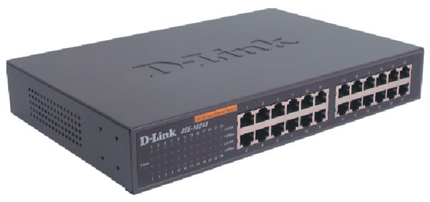
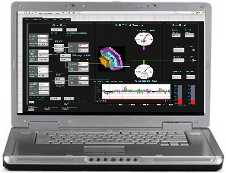
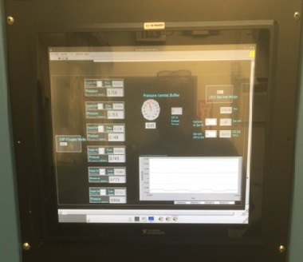
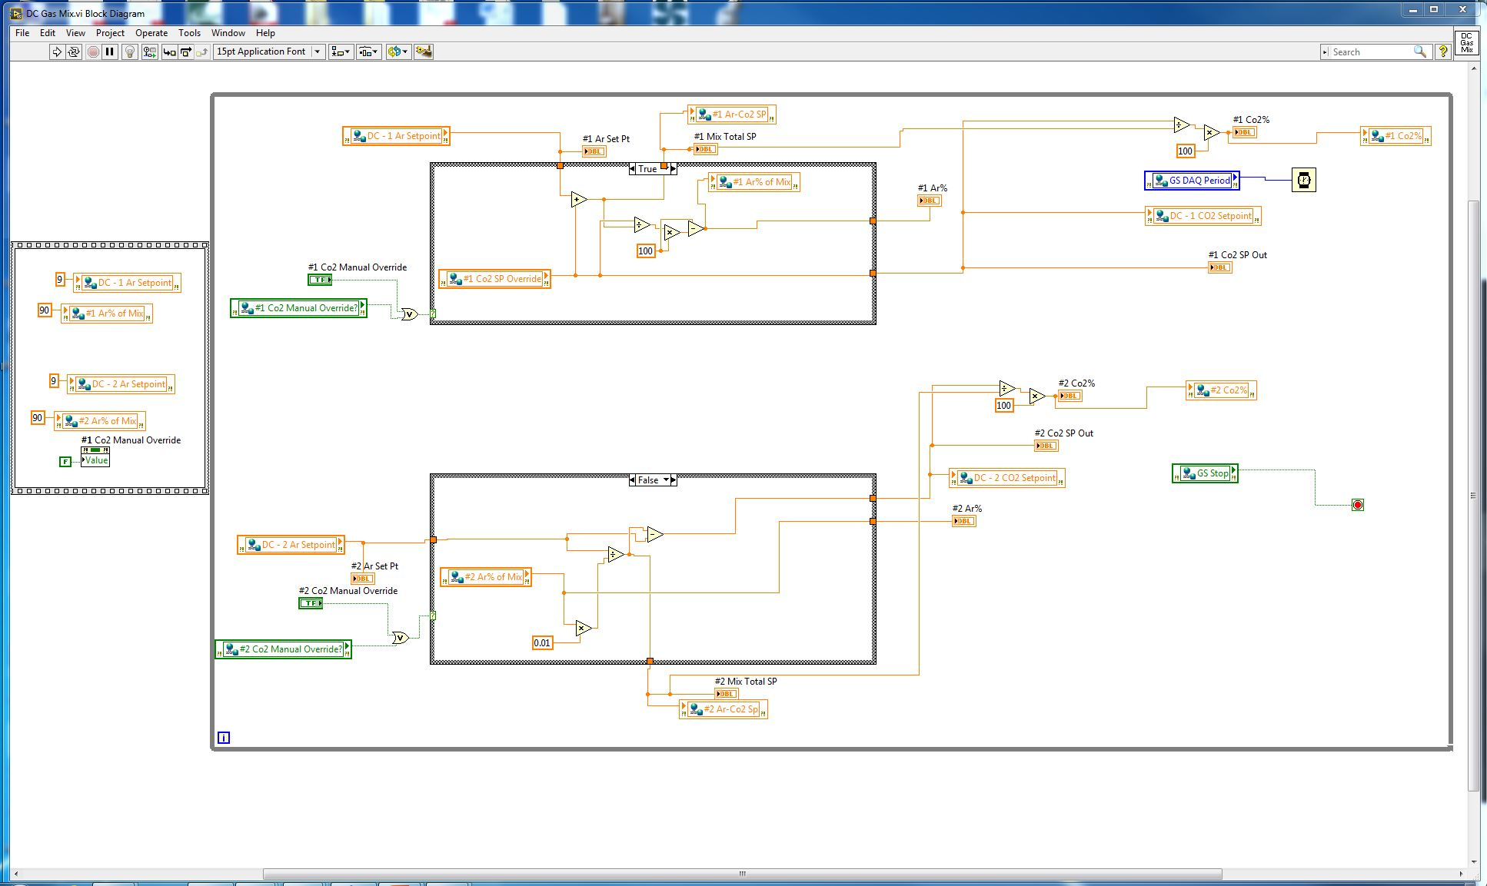
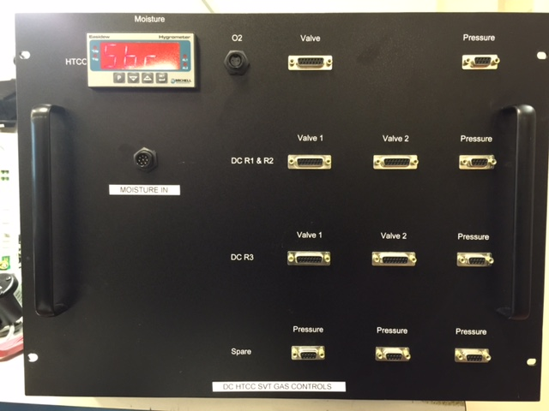
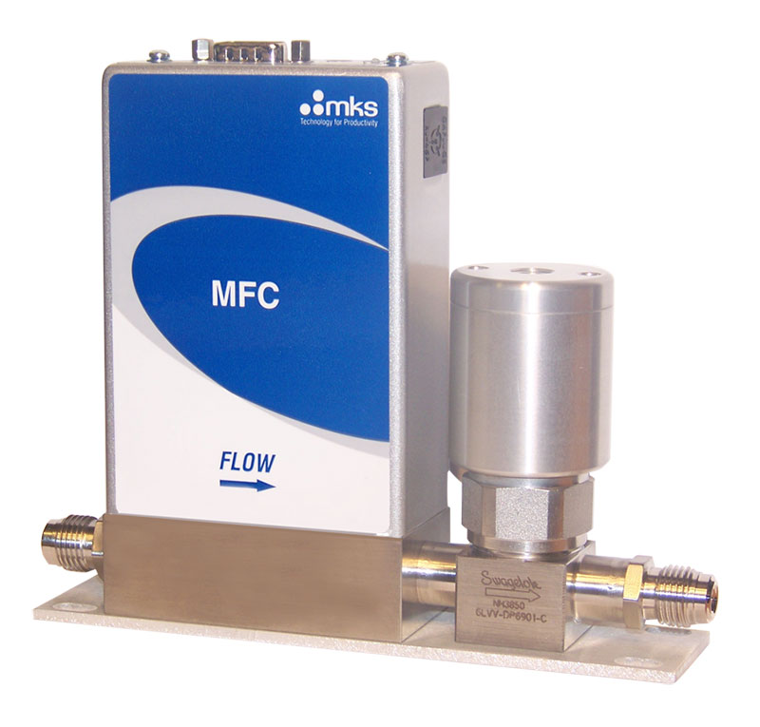
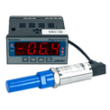
Hall B Gas Controls Connections
Network switch
Gas Flow Control and Monitoring
LabView Code
LabView Code
Gas Flow Monitoring
NI 9035 cRIO
Sensor signal
PC with LabView Software
GUI Controls
Gas Controls Interface chassis
MFC power
Sensor signal
Sensor power
MKS GE50/250
Mass Flow Controller
System sensor

Slide 7
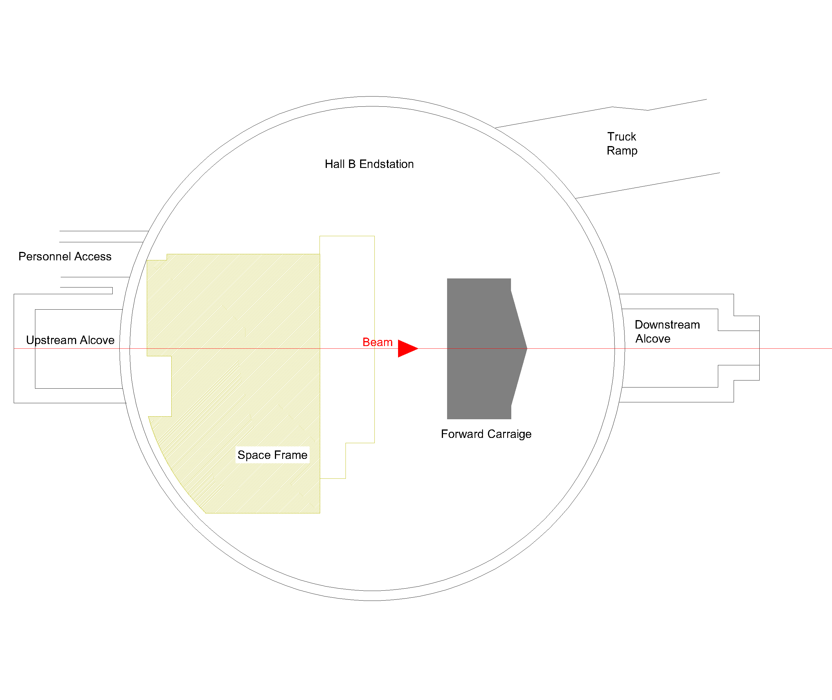
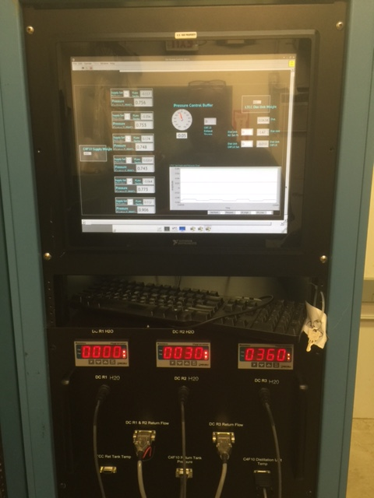
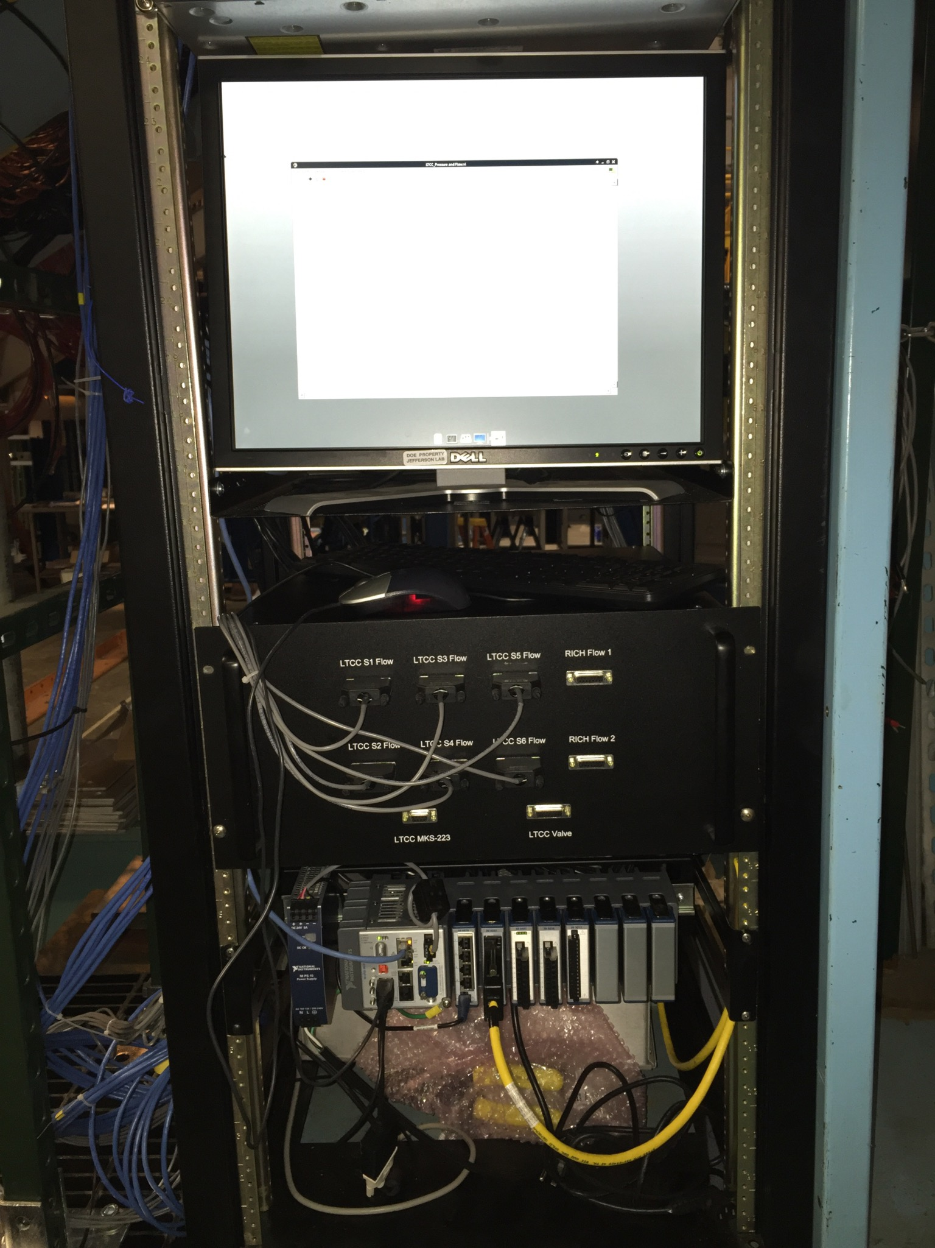
Controls system locations
Hall B End station

Slide 8
Hall B DC Gas Controls
Gas Shed
Space Frame
hb-crio-gs
Network
Switch
hb-crio-sf
Network
Switch
Network
Network
Gas Monitoring
Network
Gas Control
Pressure Control
MKS GE250 Mass Flow Controller (x3)
Analog Input
MKS 579 Mass Flow Transducers (x2)
Analog Output
MKS 223 Differential Pressure Transducer (x2)
MKS 122 Absolute Pressure Transducer (x2)
Analog Input
Ar/CO₂ Gas Mixing Control
Pressure Control Valve sets (x2)
Oxy_IQ O2 sensor (x3)
Easidew Moisture sensor (x3)
MKS GE250 Mass Flow Controller (x4)
Panametrics S3 TCU(x2)

Slide 9
Hall B LTCC Gas Controls
Gas Shed
Forward Carriage
hb-crio-gs
Network
Switch
hb-crio-fc
Network
Switch
Network
Network
Network
System Monitoring
Network
Gas Flow Control
Pressure Control
Gas Flow Control
Analog Output
Pressure Control Valve (x1)
Trancell TI 500e weight scale (x2)
MKS GE250 Mass Flow Controller (x1)
Analog Input
MKS GE50 Mass Flow Controller (x6)
MKS 223b Differential Pressure Transducer (x1)
MKS 750c High Pressure Absolute Pressure Transducer (x1)
MKS GE50 Mass Flow Controller (x1)
Analog Input
Distillation Unit Chromalox Temperature Display (x1)
Gas Monitoring and Control
Magnehelic and Omega DP25 (x6)
Solenoid valve (x12)

Slide 10
Hall B HTCC Gas Controls
Space Frame
hb-crio-sf
Network
Switch
Network
Gas Monitoring
Pressure Monitoring
Network
Gas Flow Control
Analog Input
Analog Input
Easidew Hygrometer (x1)
MKS 223b Differential Pressure Transducer (x1)
MKS GE250 Mass Flow Controller (x1)

Slide 11
Hall B SVT Gas Controls
Space Frame
hb-crio-sf
Network
Switch
Network
Network
Gas Control
MKS GE50 Mass Flow Controller (x1)

